Slide 1
Geek Perspectives
Lessons from Hybrid Mobile GIS Dev in 2018
Adnan Bilwani & Lucas Cotner

Slide 2
Agenda
Web vs. Native vs. Hybrid
Why Hybrid?
Hybrid Today
React Native
App Studio
Xamarin Forms
Summary
Questions

Slide 3
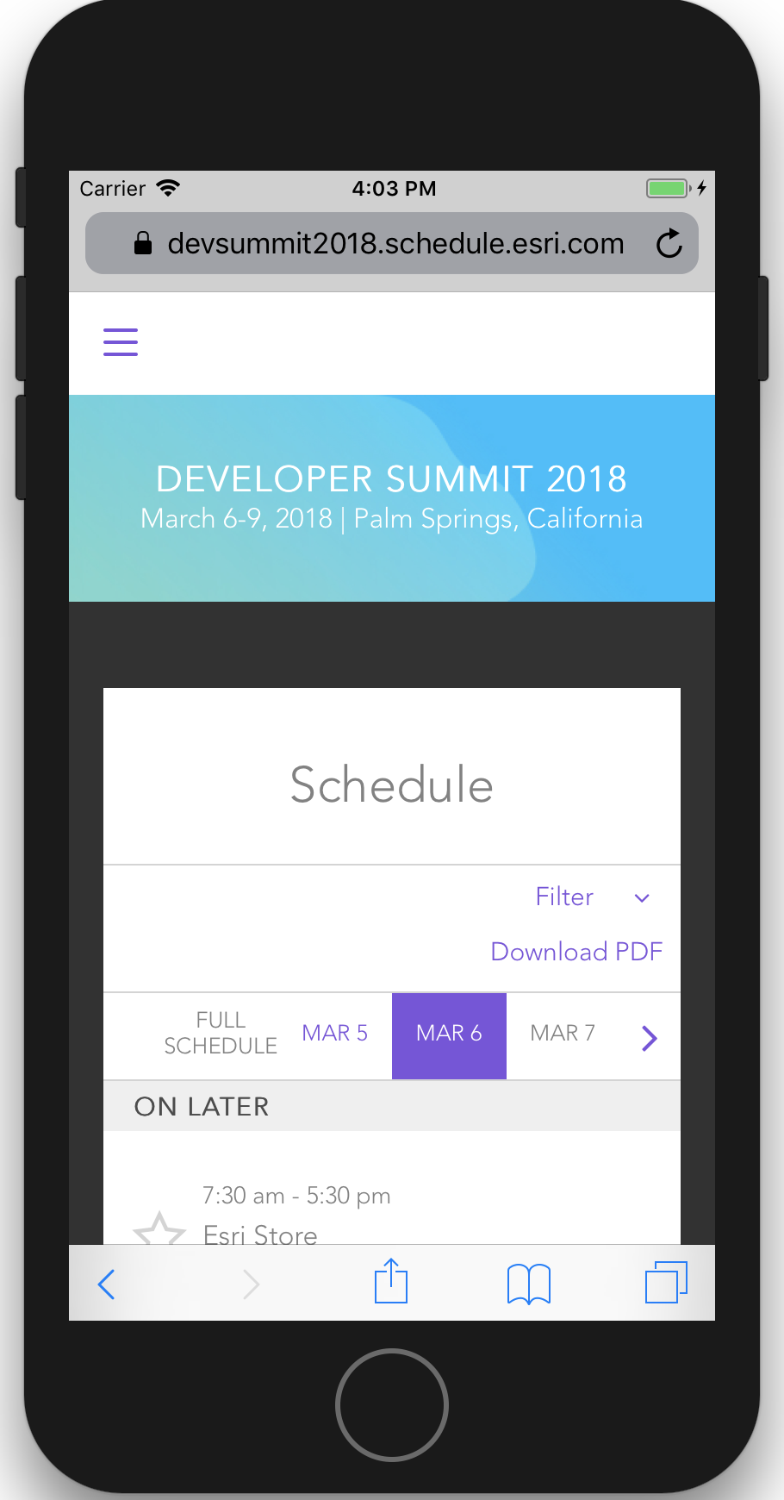
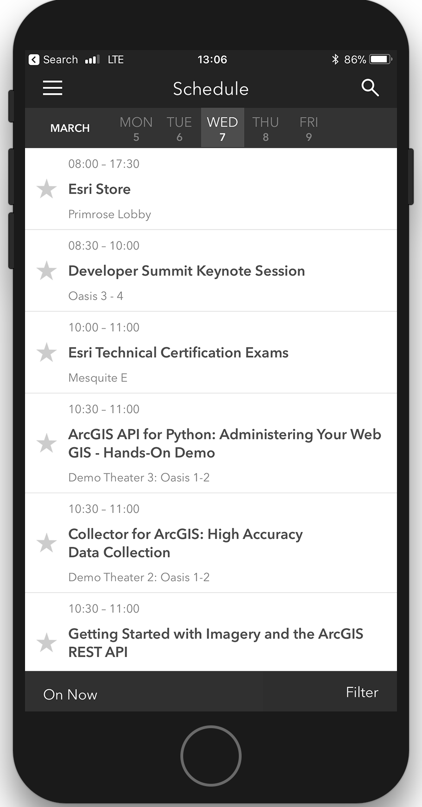



Web vs. Native vs. Hybrid
Web
Hybrid
Native
Responsive

Slide 4
Why Hybrid? (Web vs. Native vs. Hybrid)
Web | Native | Hybrid
Single App – Multiple Platforms | Multiple Apps - Per Platform | Single App – Multiple Platforms
Requires Browser/URL | Native Application on Phone | Native Application on Phone
No Hardware Access* | Hardware Access | Hardware Access
Online Only Availability | Online / Offline Availability | Online / Offline Availability
Direct Platform Support | Direct Platform Support | Indirect Platform Support
Quicker To Market | Slower To Market | Quicker To Market
Development (Single Language) | Development (Multiple Languages) | Development (Single Language)
- | User Engagement | User Engagement
Inexpensive | Expensive | Inexpensive
Reduced Maintenance | Added Maintenance | Reduced Maintenance
- | App Store Presence | App Store Presence

Slide 5








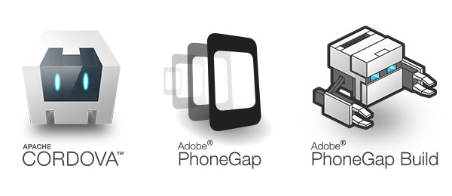

Hybrid Today

Slide 6
Hybrid Today
HTML Based Frameworks | Non-HTML Based Frameworks
Ionic | React Native (JavaScript)
Adobe PhoneGap | Xamarin (C#)
KendoUI | AppStudio (QML)
Mobile Angular UI

Slide 7


Hybrid Today

Slide 8

Native mobile apps using JavaScript & React
These apps are inherently Native! It’s not simply: - an HTML5 app - a mobile web app
Write in JS, but native code when you need it

Slide 9
React…with no Browser?
React Native does not rely on HTML5
No more <div> tags
Default React Components
No CSS!
Stylesheet support – think inline styles in React

Slide 10
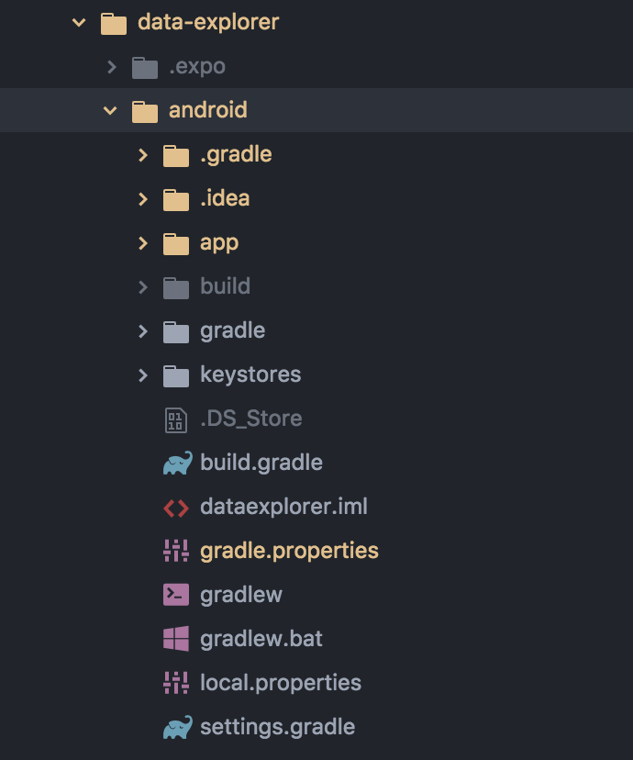
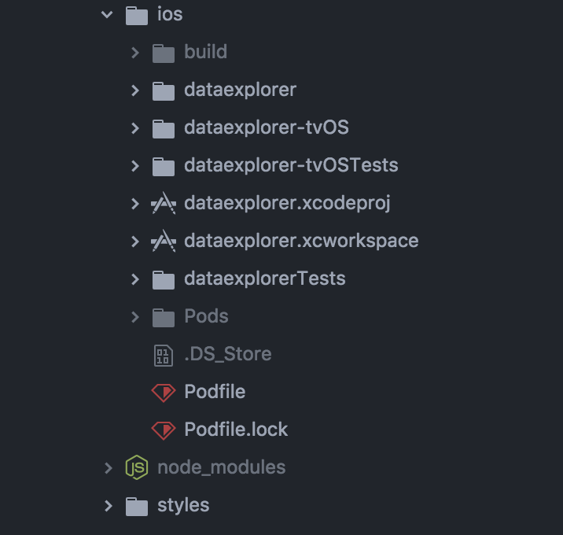
Dependencies – Android vs iOS
Storyboards

Slide 11
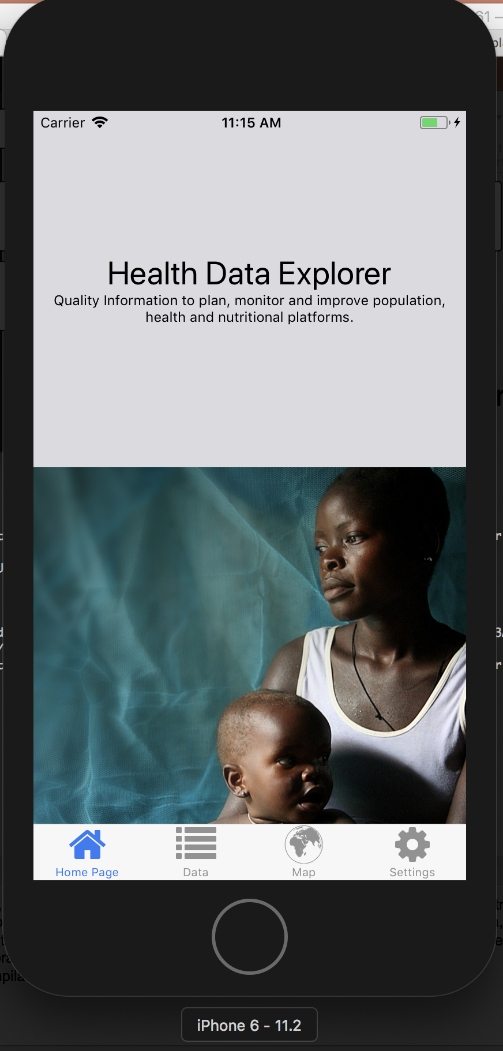
Why React Native?
Familiar UI for Web Developers
Truly Native
The Ecosystem & support
Ease of development

Slide 12
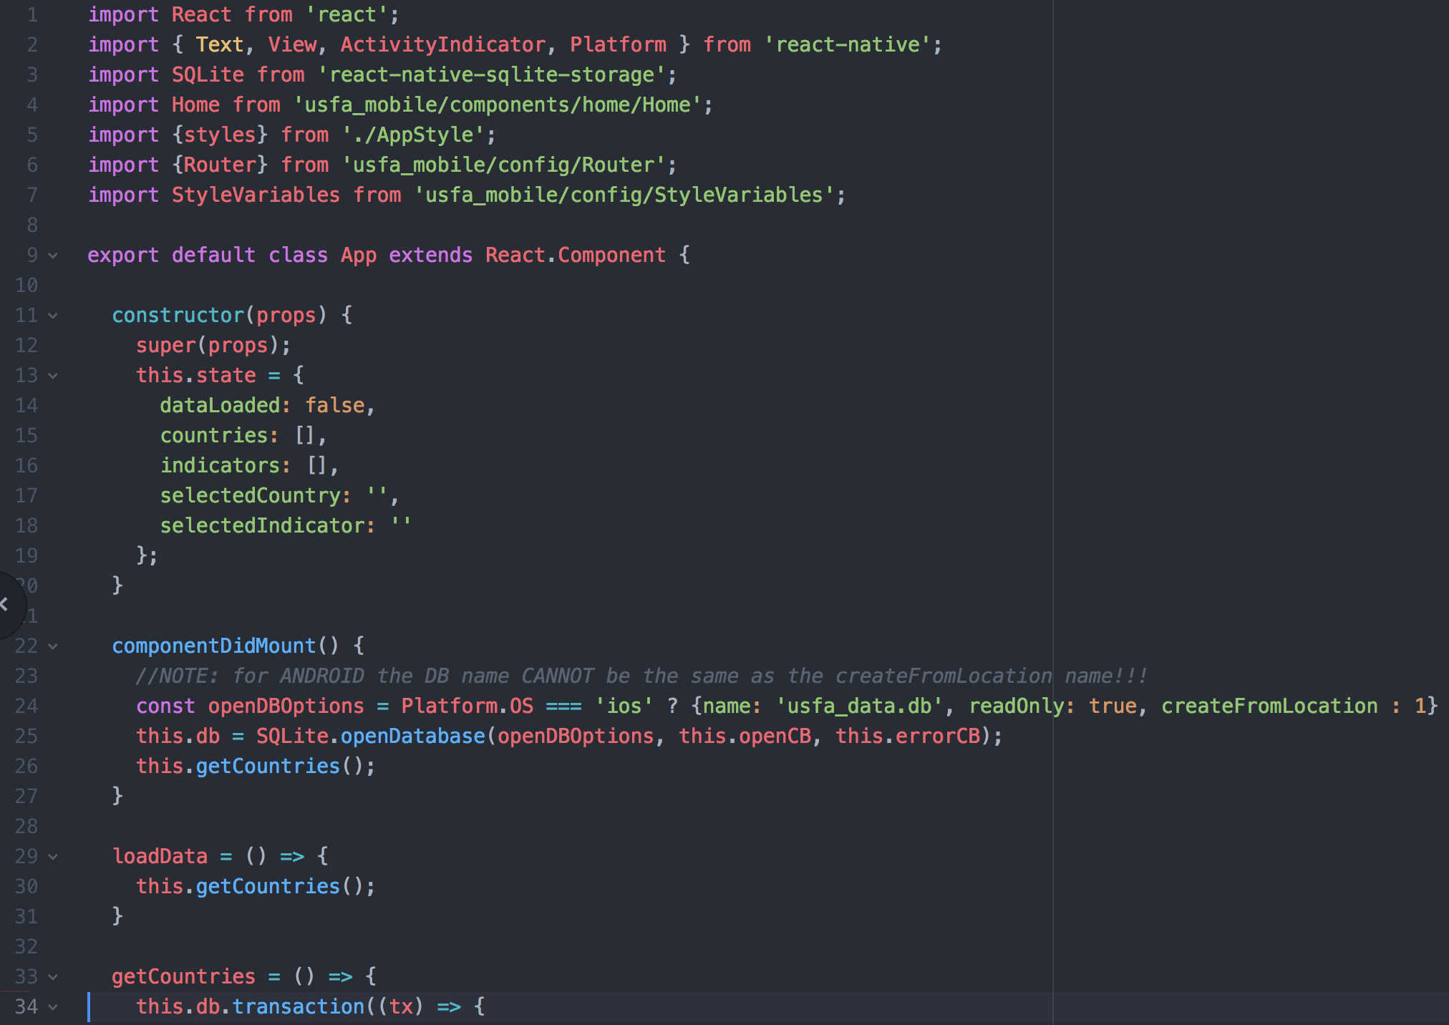
React Native - Components

Slide 13
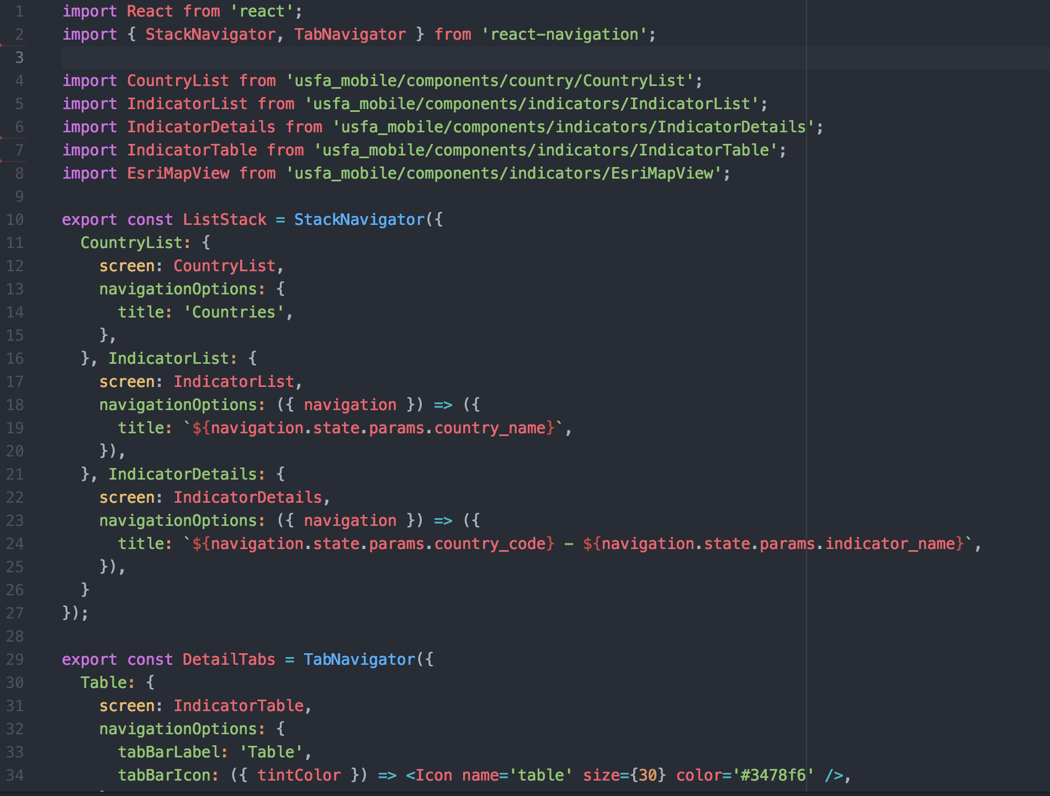
React Native - Routing

Slide 14
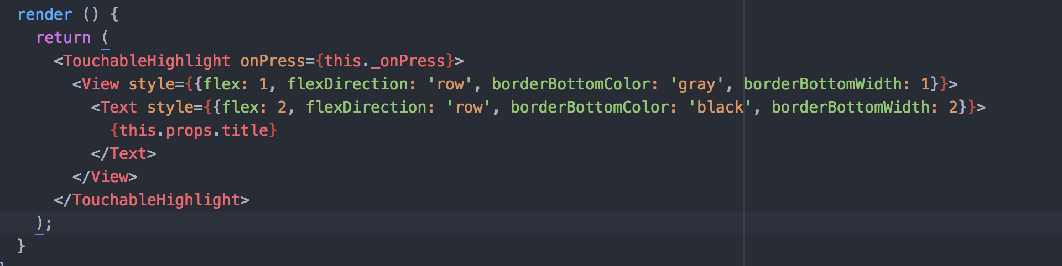
React Native - Styling

Slide 15
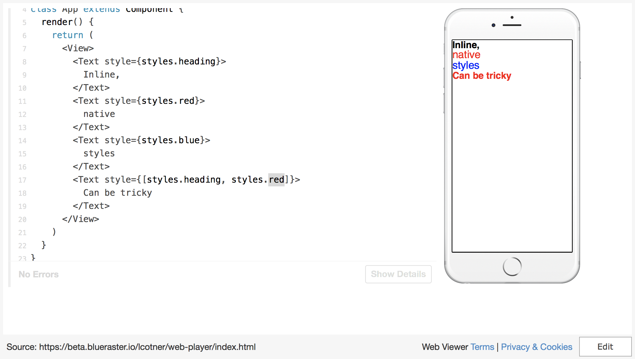
Notes:
import React, { Component } from 'react'import { AppRegistry, StyleSheet, Text, View, } from 'react-native'class App extends Component { render() { return ( <View> <Text style={styles.heading}> Inline, </Text> <Text style={styles.red}> native </Text> <Text style={styles.blue}> styles </Text> <Text style={[styles.heading, styles.red]}> Can be tricky </Text> </View> ) }}// Style sheetsconst styles = StyleSheet.create({ heading: { fontWeight: 'bold', fontSize: 14, }, red: { color: 'red', }, blue: { color: 'blue', }, green: { color: 'green', }});AppRegistry.registerComponent('App', () => App)

Slide 16
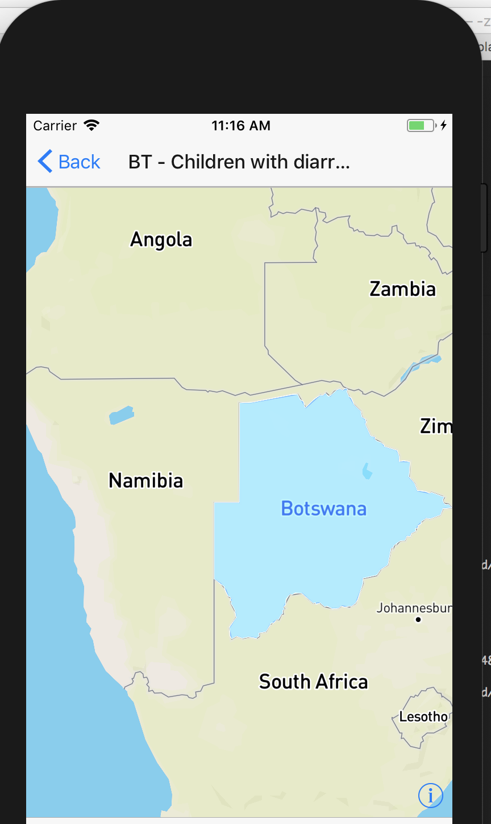
React Native – Our Experience
Dependencies!
No ESRI Support...currently
Routing – Easy!
npm module access
Overall: I like it…once it is all set up

Slide 17
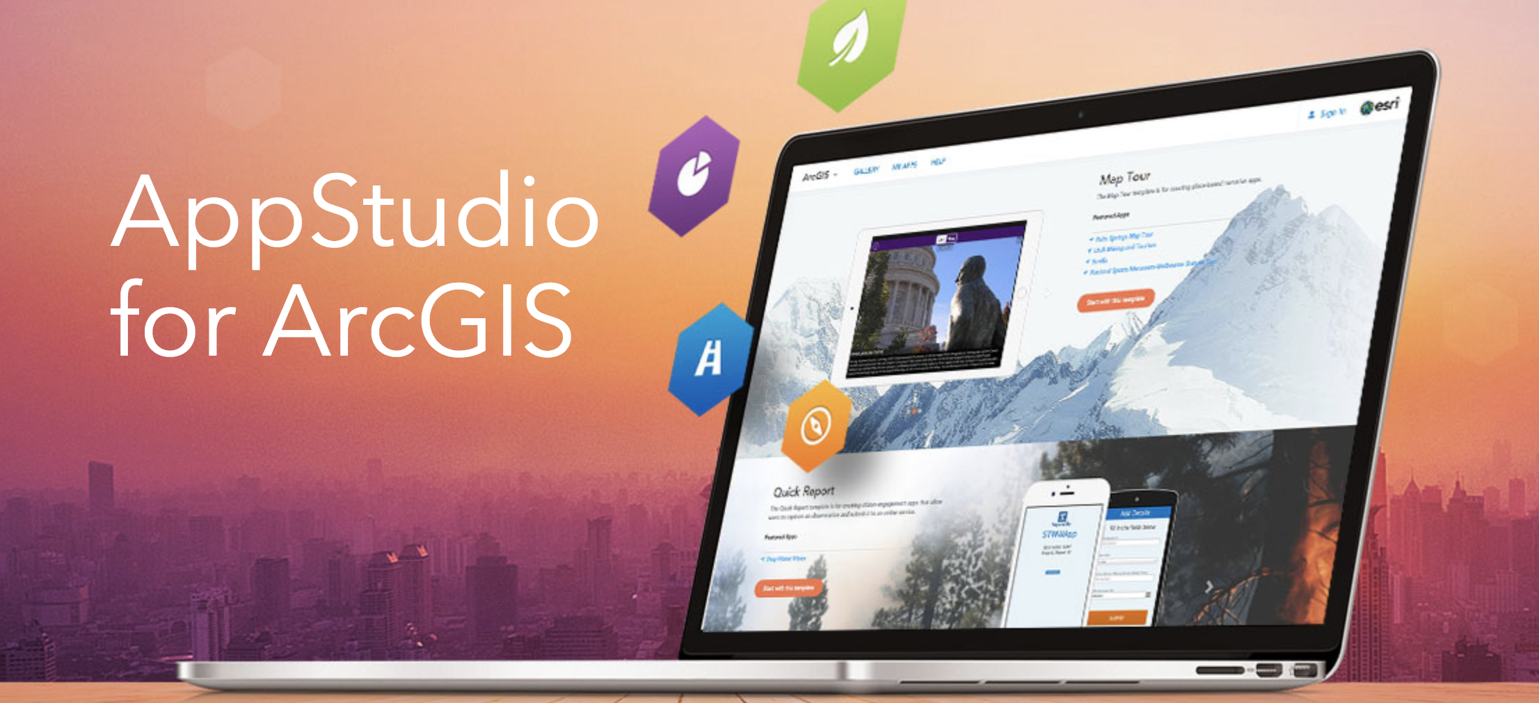

Slide 18
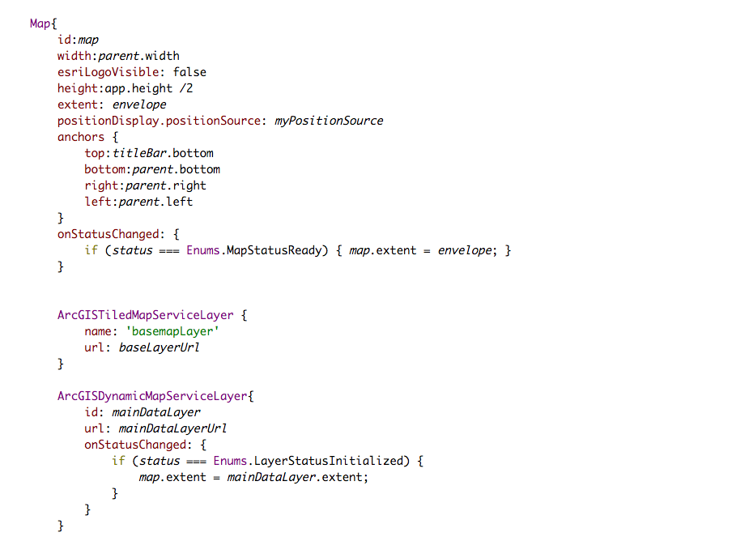
Native Code? Not Quite: Introducing QML
UI Spec, language
JSON-like syntax
Native components
Lifecyclish methods
Custom callbacks

Slide 19
Why AppStudio?
It supports ArcGIS
ESRI is behind it 100%
Write once, build twice, and you’re done
Deployment is (relatively) easy

Slide 20
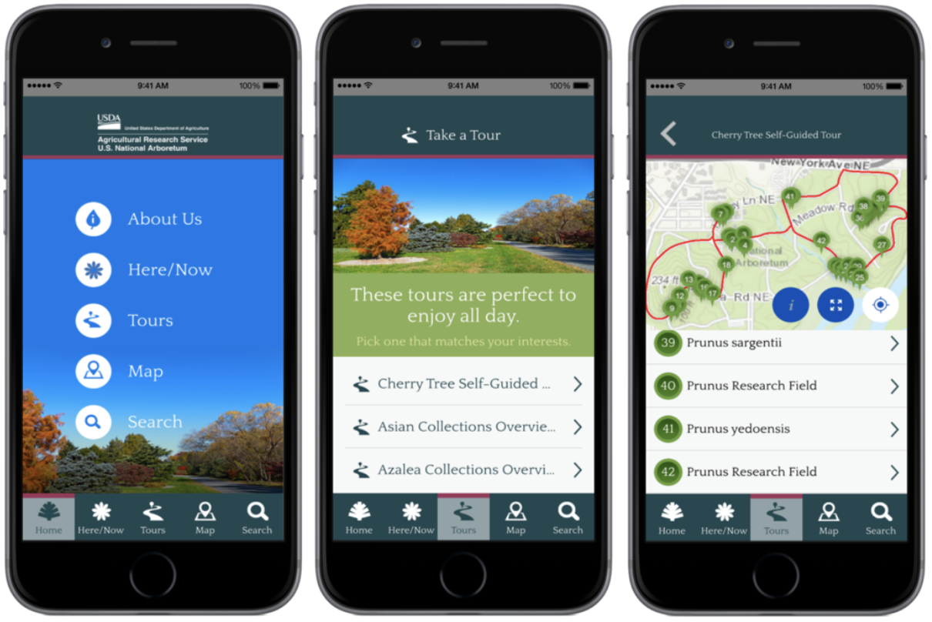
App Studio– Our Experience
Not your avg. web experience
Great Esri support
Deployment – Not bad!
QT and QML – not intuitive to a web developer such as myself
Overall: Good choice for quick Esri-centric development with templates and great support.

Slide 21
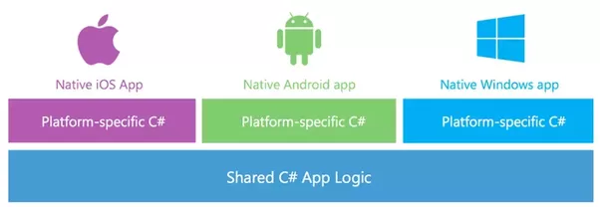
Xamarin
Xamarin Native
Separate UI, Shared Business Logic

Slide 22
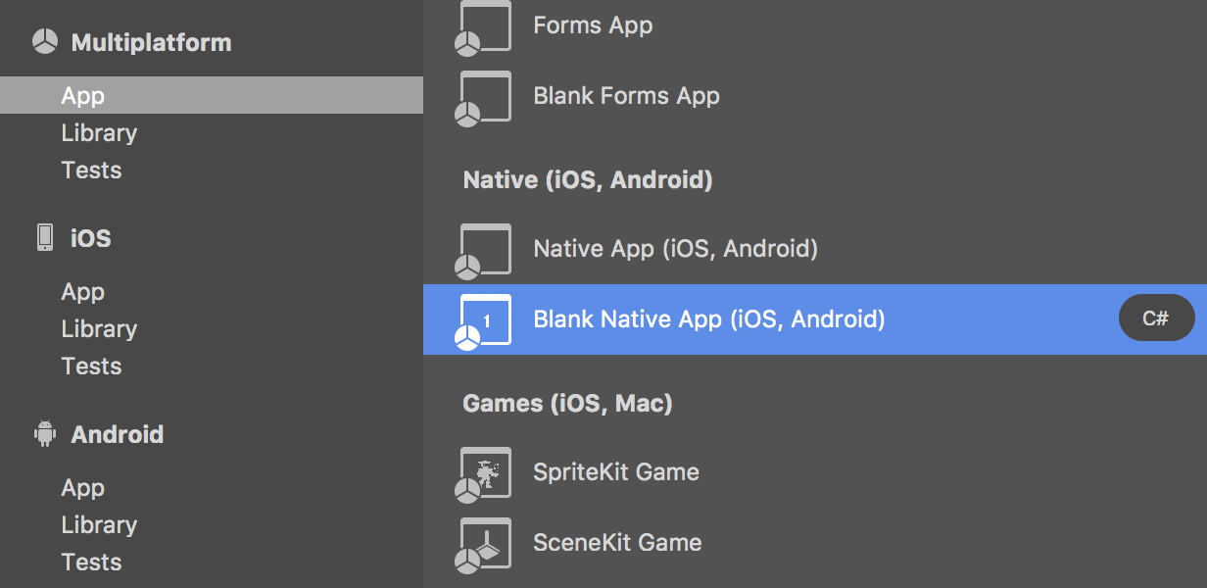
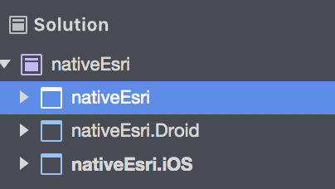
Xamarin - Native
- Mac: iOS/Android
- Windows: iOS/Android/UWP
Individual project for iOS and Android (UI)
Shared Project for business logic

Slide 23
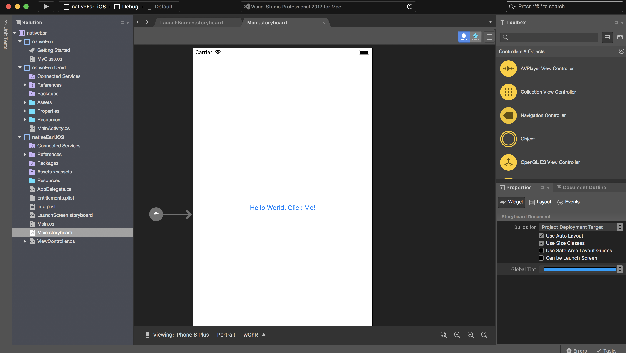
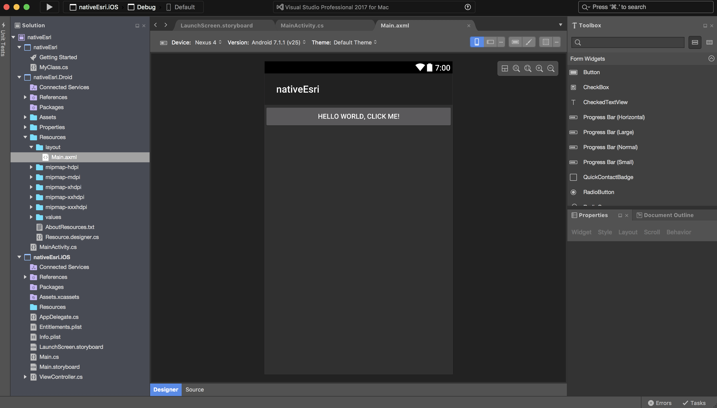
Xamarin - Native
Storyboards
Layouts
Notes:
The native UI projects use storyboards for iOS and Layouts for Andoid.
You do need to know the UI and design guidelines for both, and you get very similar interfaces to Xcode and Android Studio, but you can share the business logic.

Slide 24
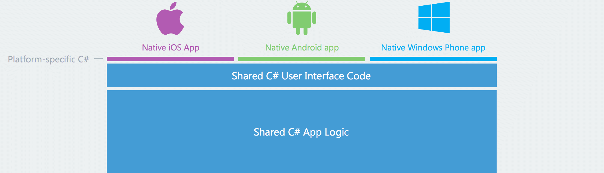
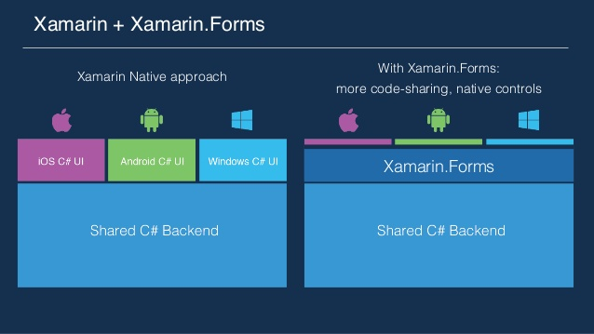
Xamarin Forms

Slide 25
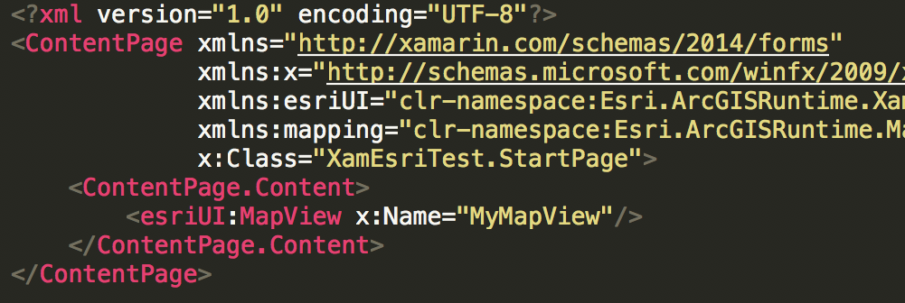
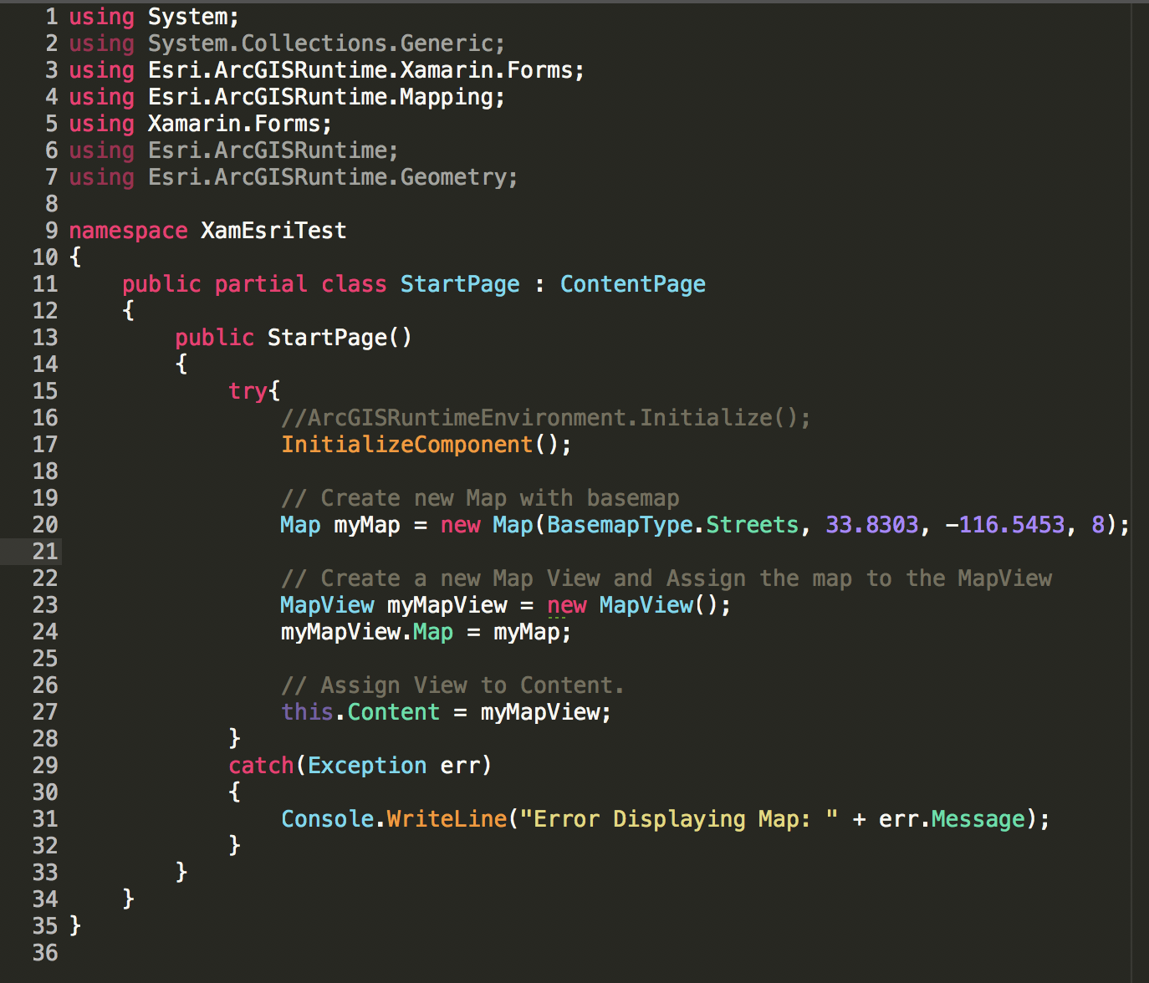
Xamarin - Forms
Use XAML (Extensible Application Markup Language)
C# (Define UI and functionality)

Slide 26
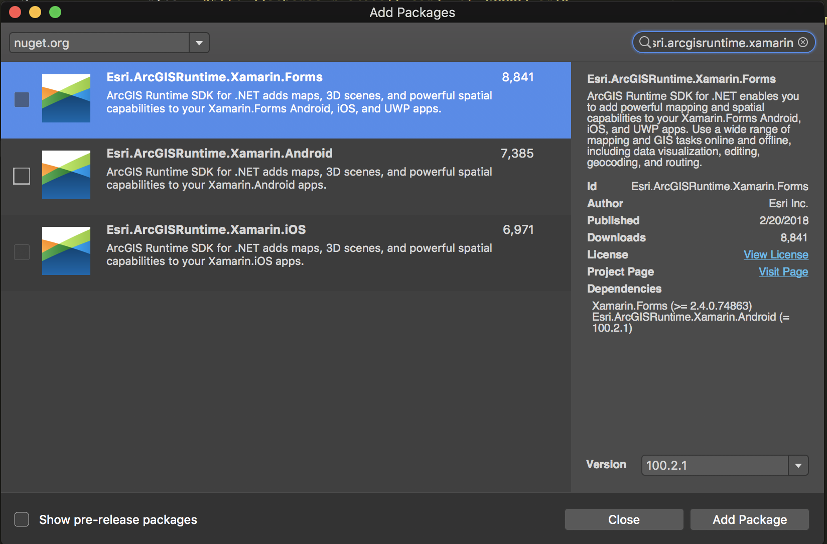
Xamarin: Esri Support

Slide 27
Xamarin: Our Experience
Xamarin
Solid IDE with good package support
You need to know .NET
Official Esri Support
Xamarin Forms:
Quick and easy way to start
Pretty solid
Shared UI always has differences between Android/iOS
Have the ability to write Platform specific with XAML
Xamarin Native
Need to have more in depth knowledge of UI design with both Android and iOS
Allows flexibility in design
I like it!

Slide 28
Final Thoughts!
There is no single correct answer
Base checklist:
☐ What technology expertise do I have in-house? (.NET, JavaScript, QML, etc.)
☐ Do my users require access to general integration (Camera, GPS, etc.)?
☐ Do my users require access to specific integration GPU (GPU, subscriptions, third party devices, etc.)?
☐ Offline access?
☐ Timeline?
☐ Budget?
☐ Maintenance Restrictions?
☐ Audience?

Slide 29


Questions!
Thank you!
Lucas Cotner
lcotner@blueraster.com
Adnan Bilwani
abilwani@blueraster.com
https://github.com/blueraster/geek-perspectives

